Slide 1
Chapter 21
Structured Streaming Basics

Slide 2
Structured Streaming uses existing APIs
DateFrames
Datasets
SQL

Slide 3
Structured Streaming (cont.)
Treat a stream of data as a table to which data is continuously appended
should not have to change your query’s code
You should specify only whether to run that query in a batch or streaming fashion

Slide 4
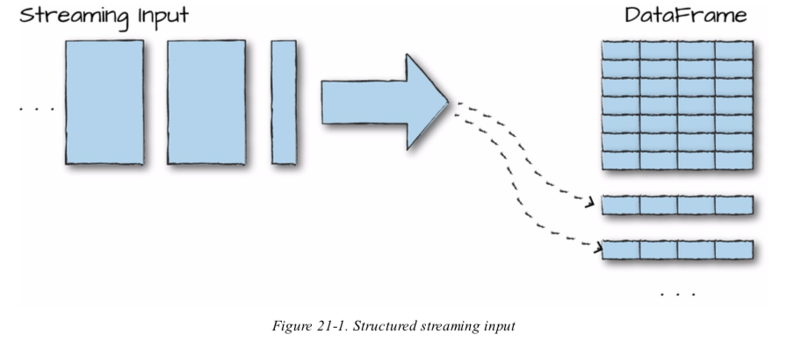
Structured Streaming (cont.)
Automatically figure out how to “incrementalize” your query

Slide 5
Continuous applications
Is an end-to-end application that reacts to data in real time by combining a variety of tools
Streaming jobs
Batch jobs
Joins between streaming and offline data
Interactive ad-hoc queries

Slide 6
Core concepts
There aren’t many because Structured Streaming is designed to be simple

Slide 7
Transformations and Actions
Maintain the same as we learned in this book before
Transformations:
with few restrictions
ex: some types of queries that the engine can’t incrementalize yet, although
some of the limitations are being lifted in new versions of Spark

Slide 8
Transformations and Actions
Action:
only one action
That are starting a stream which will then run continuously and output results

Slide 9
Input Sources
Structured Steaming supports several input sources for Spark 2.2:
Apache Kafka 0.10
Files on a distributed file system like HDFS or S3
A socket source for testing

Slide 10
Sinks
Sinks specify the destination for the result set of that stream
Supported output sinks for Spark 2.2:
Apache Kafka 0.10
Almost any file format
A foreach sink for running arbitary computation on the output records
A console sink for testing
A memory sink for debugging

Slide 11
Output modes
After defining a sink for our structured streaming job
We need to define how we want Spark to write data to that sink
Ex: only want to append new info?
want to update rows as we receive more info about them over time?
want to completely overwrite the result set every single time?

Slide 12
Output mode(cont.)
The supported output modes :
Append (only add new records to the outputs sink)
Update ( update changed records in place)
Complete (rewrite the full output)

Slide 13
Output mode(cont.)
Important detail : certain queries and certain sinks only support certain output modes
Ex: your job is just performing a map on a stream, the output will as new records arrive, so use Complete mode will be no sense
Ex: if you are doing an aggregation into a limited number of keys, Complete and Update modes make sense, but Append would not.

Slide 14
Triggers
Output modes define how data is output
Triggers define when data is output

Slide 15
Event-Time Processing
SS also support for event-time processing
Ex: processing data based on timestamps included in the record that may arrive out of order
Two key ideas:
Event-time data
Watermarks

Slide 16
Structured Streaming in Action

Slide 17
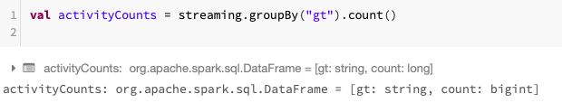
Streaming DataFrame
Like other Spark APIs, creation and execution is lazy

Slide 18
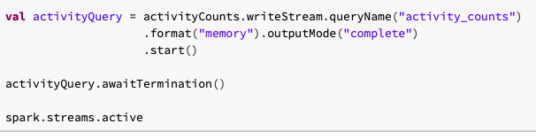

Streaming DataFrame(cont.)
Notes:
Switch speakers next

Slide 19
Transformations on Streams
Select
Filter
Simple transformations
All DF functions
Individual column manipulations
Notes:
New speaker

Slide 20
Limitations on Transformations
Transformations that do not make sense in context of streaming data
Ex: as of Spark 2.2, users cannot sort streams that are not aggregated.
Cannot perform multiple levels of aggregation without using Stateful Processing
Limitations may be subjected to being lifted upon further development.

Slide 21
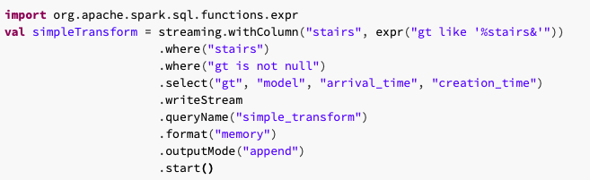
Selections and Filtering

Slide 22
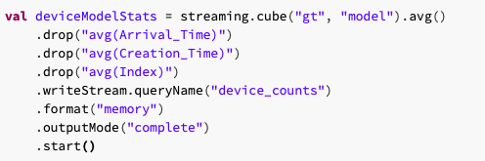
Aggregations

Slide 23
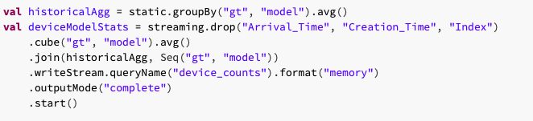
Joins

Slide 24
Input and Output
How sources, sinks and output modes work in Structured Streaming.
Specifically discuss how, when and where dataflows into and out the system

Slide 25
Where Data Is Read and Written (Sources and Sinks)
File source and sink
Kafka source and sink
More may be added over time.

Slide 26
File source and sink
Simplest source is the simple file source
Ex: Parquet, text, JSON, CSV
Only difference between file source/sink and static file source:
with streaming we can control the number of files that we read in during each trigger (maxFilesPerTrigger) option
Keep in mind: any file you add into an input directory for a streaming job need to appear in it atomically

Slide 27
How Data Is Output (Output Modes)
Three modes:
Append mode
Compete mode
Update mode

Slide 28
Append mode
Is the default behavior.
When new rows are added to the result table, they will be output to the sink based on the trigger that you specify
Ensures that each row is output once (and only once), assuming you have a fault-tolerant sink.

Slide 29
Complete mode
Will output the entire state of the result table to your output sink
Useful when you’re working with some stateful data for which all rows are expected to change over time or the sink you are writing does not support row-level updates

Slide 30
Update mode
Is similar to complete mode except that only the rows that are different from the previous write are written out to the sink.
Your sink must support row-level updates to support this mode

Slide 31
When to use each mode?
Structured streaming limits your use of each mode to queries where it makes sense.
Following table when you can use each output mode:

Slide 32
Query Type | Query type (continued) | Supported Output Modes | Notes
Queries with aggregation | Aggregation on event-time with watermark | Append, Update, Complete | Append mode uses watermark to drop old aggregation state. This means that as new rows are brought into the table, Spark will only keep around rows that are below the “watermark”. Update mode also uses the watermark to remove old aggregation state. By definition, complete mode does not drop old aggregation state since this mode preserves all data in the Result Table.
 | Other aggregations | Complete, Update | Since no watermark is defined, old aggregation state is not dropped. Append mode is not supported as aggregates can update thus violating the semantics of this mode.
Queries with mapGroupsWithState |  | Update
Queries with flatMapGroupsWithState | Append operation mode | Append | Aggregations are allowed after flatMapGroupsWithState.
 | Update operation mode | Update | Aggregations not allowed after flatMapGroupsWithState.
Other queries |  | Append, Update | Complete mode not supported as it is infeasible to keep all unaggregated data in the Result Table.

Slide 33
When data is output (Triggers)
We set trigger to control when data is output to our sink
Processing time trigger
Once trigger

Slide 34

Processing time trigger
We simply specify a duration as a string
It will wait for multiples of the given duration in order to output data.
Ex: with a trigger duration of one minute, the trigger will fire at 12:00, 12:01, 12:02
and so on.

Slide 35

Once trigger
You can just run a streaming job once by setting that as the trigger
It’s useful in both development and production.
During development you can test your application on just one trigger’s worth of data at a time.
During production the once trigger can be used to run your job manually at a low rate(ex, import new data into a summary table just occasionally)

Slide 36
Streaming Dataset API
You are not limited to just the DataFrame API for streaming
You also can use Datasets to perform the same computation but in type-safe manner.
Turn DataFrame into a Datasets the same way as we did before.
The Dataset’s elements need to be Scala case classes or Java bean classes

Slide 37
